Slide 1
WayFind
Jacob Foote, Levi Cooper, Sebastian Grabill, Kwame Adubofour, Samuel Ntadom

Slide 2
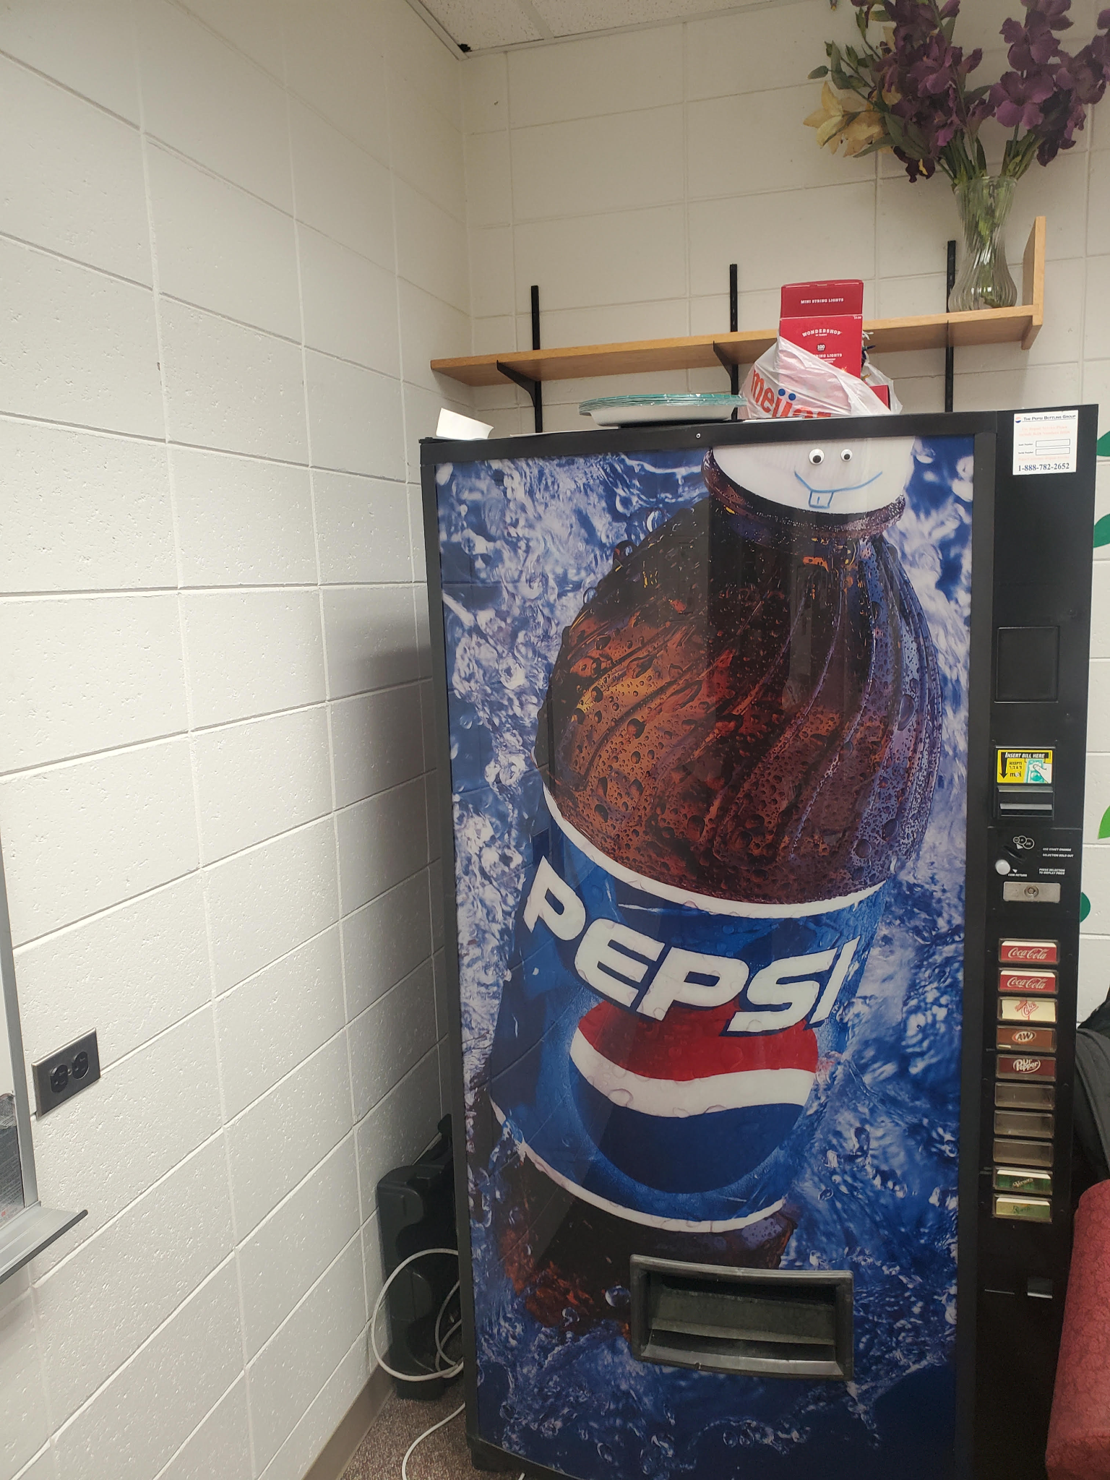
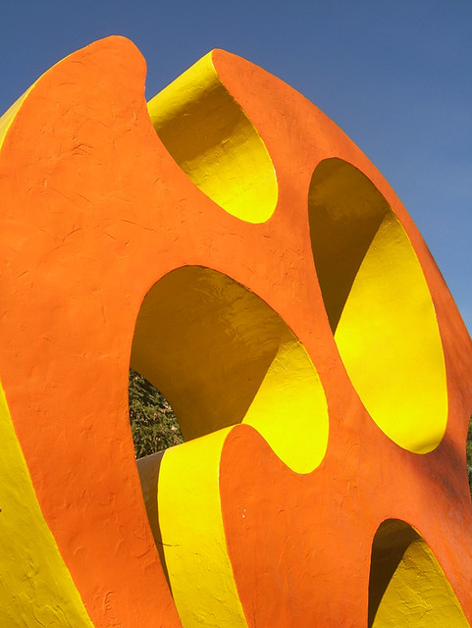
Notes:
Can someone tell me what these pictures have in common?
That’s right, they’re both iconic niche Calvin Landmarks – the cheese and the only cola machine
But they’re both in out of the way lesser known places, so in order to bring more people to see the many interesting/unique places that exist on campuses, we created wayfind.

Slide 3
Vision
Vision Statement
Geocaching and collectathon app
Transforms campus into an interactive adventure
Encourage exploration and discovery
Collect tokens and badges
Compete with other students
Broad Vision goals
Personalizable and customized experiences
Provide communities with personalized orientation activities
Provide plentiful and accessible puzzles
Notes:
Wayfind is a Calvin geocaching and collectathon app that transforms campus into an interactive adventure. Students can explore by collecting virtual tokens at GPS locations tied to landmarks, buildings, and hidden spots. They find these tokens through solving puzzles and following clues. Users will create their own custom scavenger hunts, allowing the community to design challenges for others and share unique experiences. A map-based interface, digital gallery (“Calvin-dex”), and rewards such as badges, streaks, and leaderboards will encourage discovery, problem-solving, and friendly competition.
While apps like Pokémon GO or general geocaching platforms provide broad, global experiences, they lack customization for local environments and persistent community engagement. Traditional scavenger hunt apps often offer only one-off experiences. Our app fills this gap by combining location-based gameplay, puzzle-solving, and community-generated content tailored to campus life. Beyond Calvin, the platform could scale to schools, museums, and local communities, supporting orientation activities, tourism, and interactive cultural events.

Slide 4
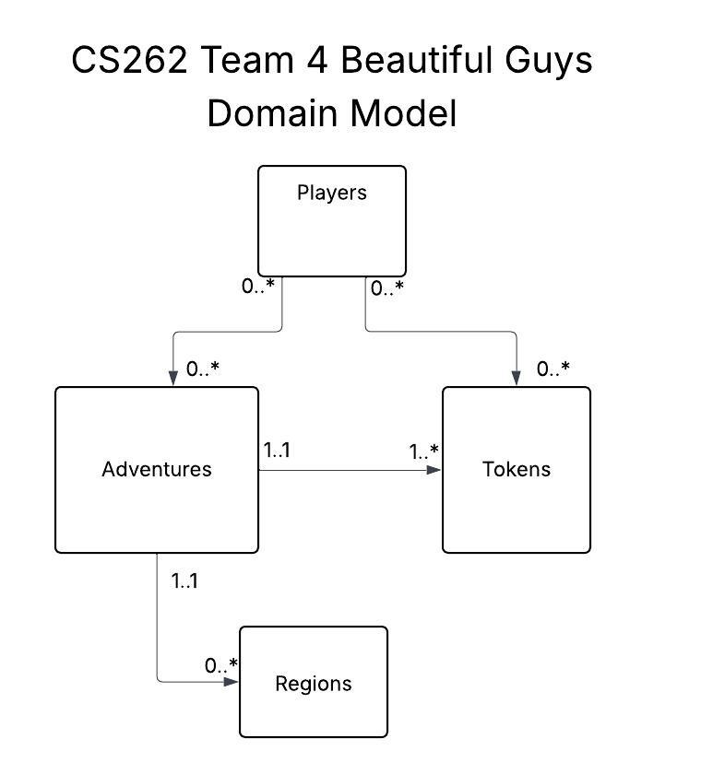
Analysis & Design
Notes:
Kwame
Talk about the definitions of the 4 components and a bit about their relationships

Slide 5
Status Report
Completed
Pages
Login
Home
Map
Profile
Features
View Adventures
View Profile
Postgresql Database
Azure Web Service (almost)
Map Integration
Not Completed
Pages
Create Region/Adventure
Adventure In Progress
Creation
Create Region
Create Adventure
Features
Playing Adventure
Azure Fetches
Updating Profile/Adventure/Region
Authentication & Security

Slide 6
Questions
Links to previous slides
Vision
Domain Model
UI Model
Status Report

Slide 7
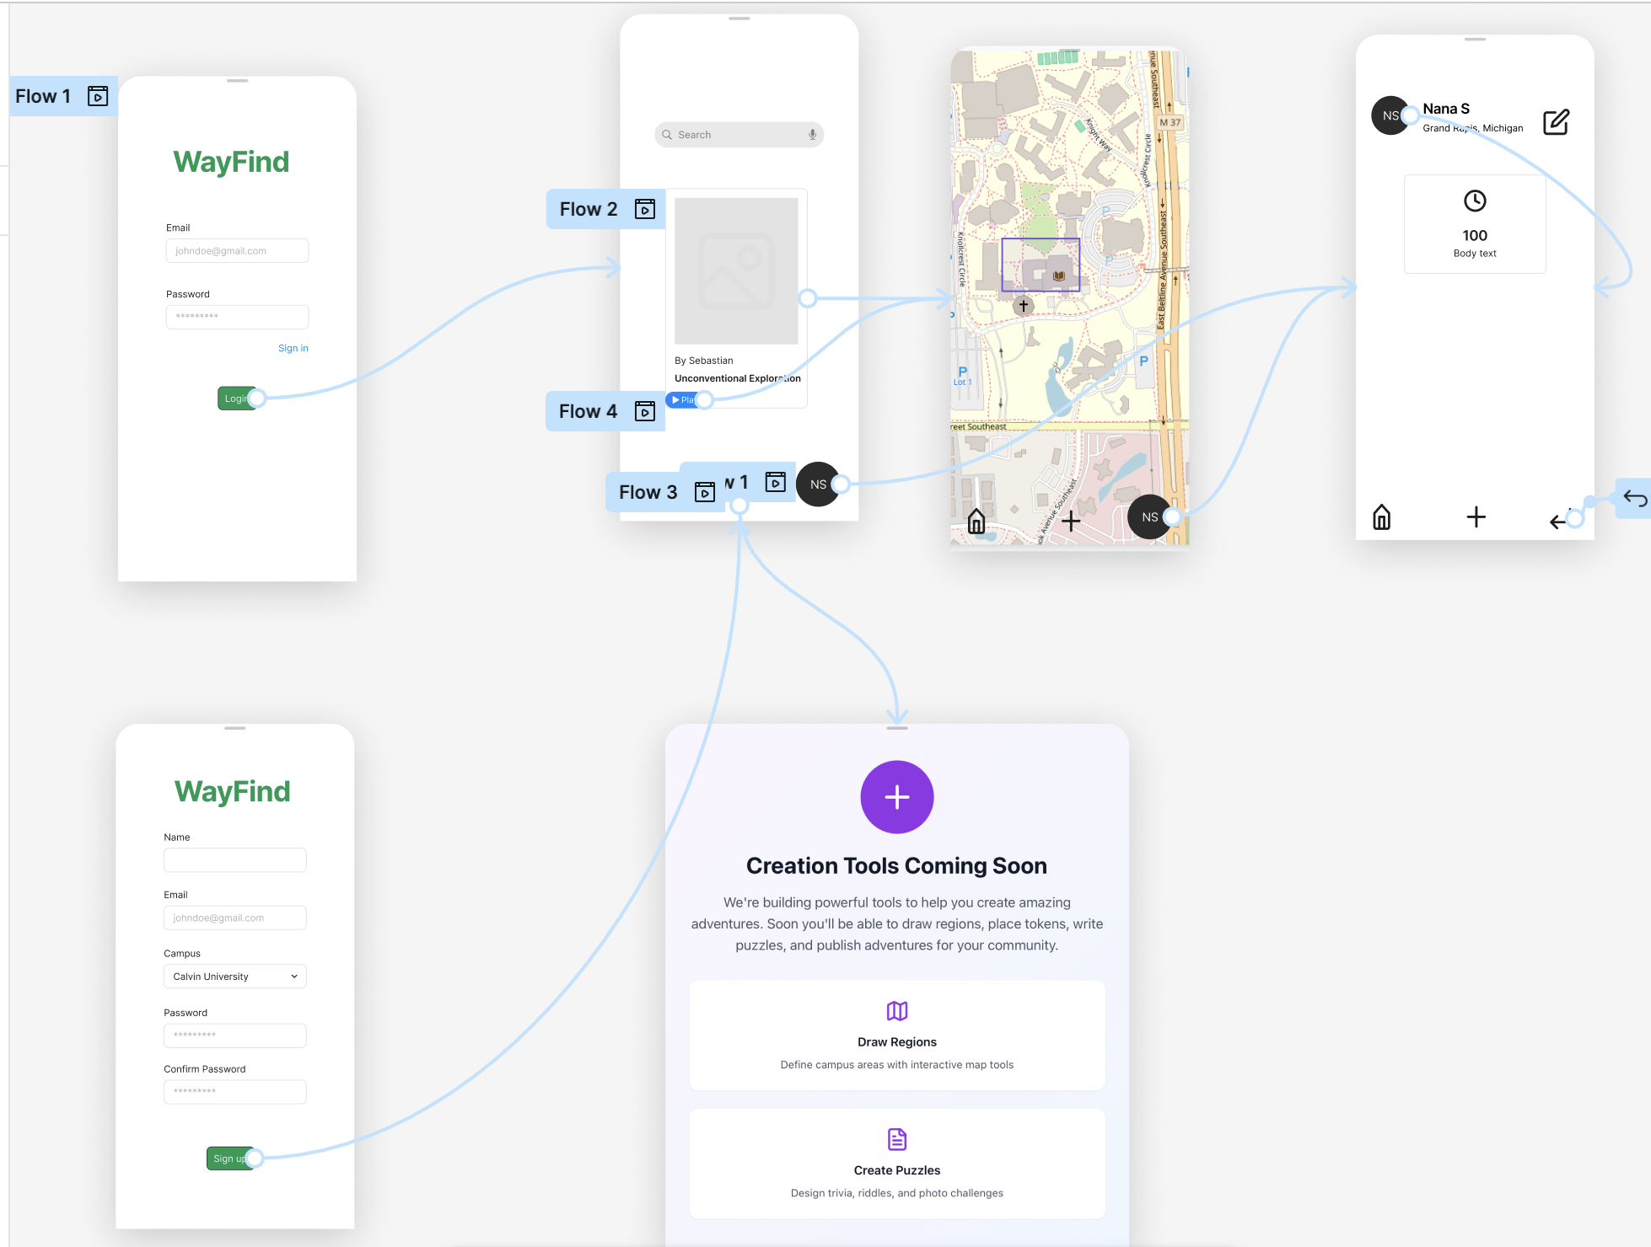
Analysis & Design
UI Model
Notes:
Levi

Slide 8
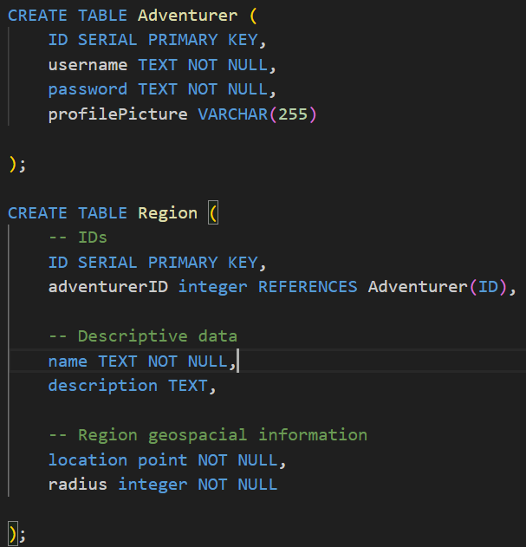
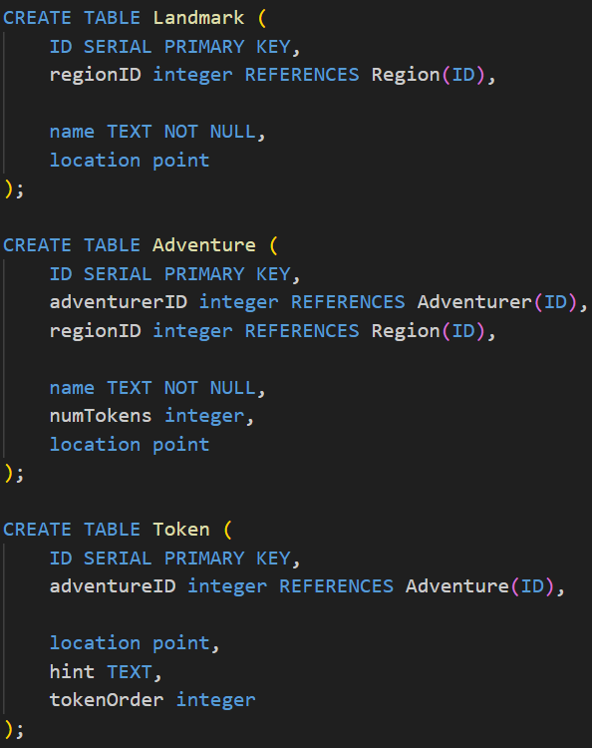
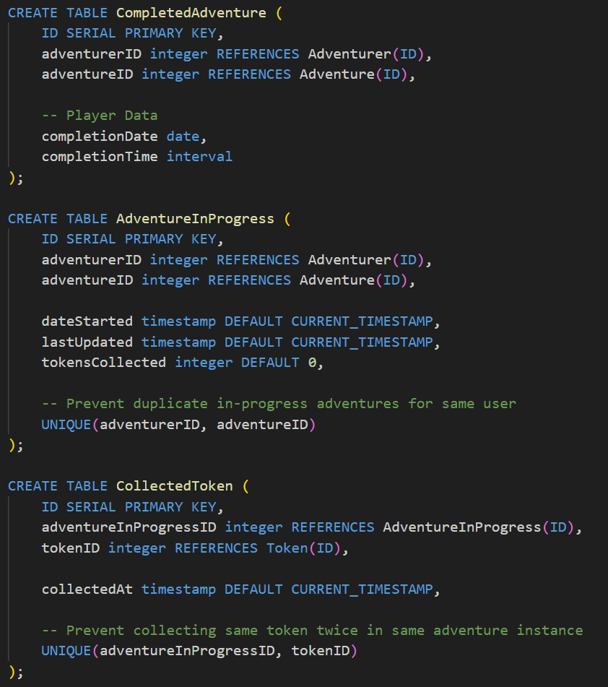
Information Systems Design
Join Tables
Notes:
Note complexity, be quick, don’t hover on this slide
Mention join tables Completed Adventure/AdventureInProgress

Slide 9
User Stories
Current
Interactive Stories
Search and play adventuress
Create and view profile
Creative Stories
Create region
Add landmarks
Define “play area”
Create adventure
Add tokens
Make hints
Define sequencing
Future
Interactive Stories
View leaderboards
Compare completion stats
“Favorite” adventures
“Upvote” regions
Virtual pets?
Creative Stories
Scheduled Adventure
Set date
Set time
Limited participants

Slide 10
Demonstration Outline (REMOVE BEFORE PRESENTING)
Demonstration - Demonstrate login - Navigate to profile - Discuss profile user stories and future implementation - Navigate to home page - Discuss database/azure web service - (make sure app is loaded before presenting since fetch takes a while) - Discuss database schema - Note join tables - Navigate to create page - Discuss future implementations -> go back to slides
- Create region takes you to map page then talk about map and regions

